Slide 1


A boxology of architectural patterns for combining learning and reasoning
Frank van Harmelen
Annette ten Teije
Vrije Universiteit Amsterdam
Creative Commons License CC BY 3.0:
Allowed to copy, redistribute remix & transform
But must attribute

Slide 2
The Doug Lenat thing:
Goal:
Create some structure in the huge number of proposals for combining learning and reasoning
Contribution:
A set of re-usable architectural patterns for such systems
“A boxology is a representation of an organized structure as a graph of labeled nodes ("boxes") and connections between them (as lines or arrows).”)

Slide 3

The AI stairway?
Connectionist
Data
Statistics
Learning
Symbolic
Knowledge
Logic
Reasoning

Slide 4

The AI pendulum!
Connectionist
Data
Statistics
Learning
Symbolic
Knowledge
Logic
Reasoning

Slide 5
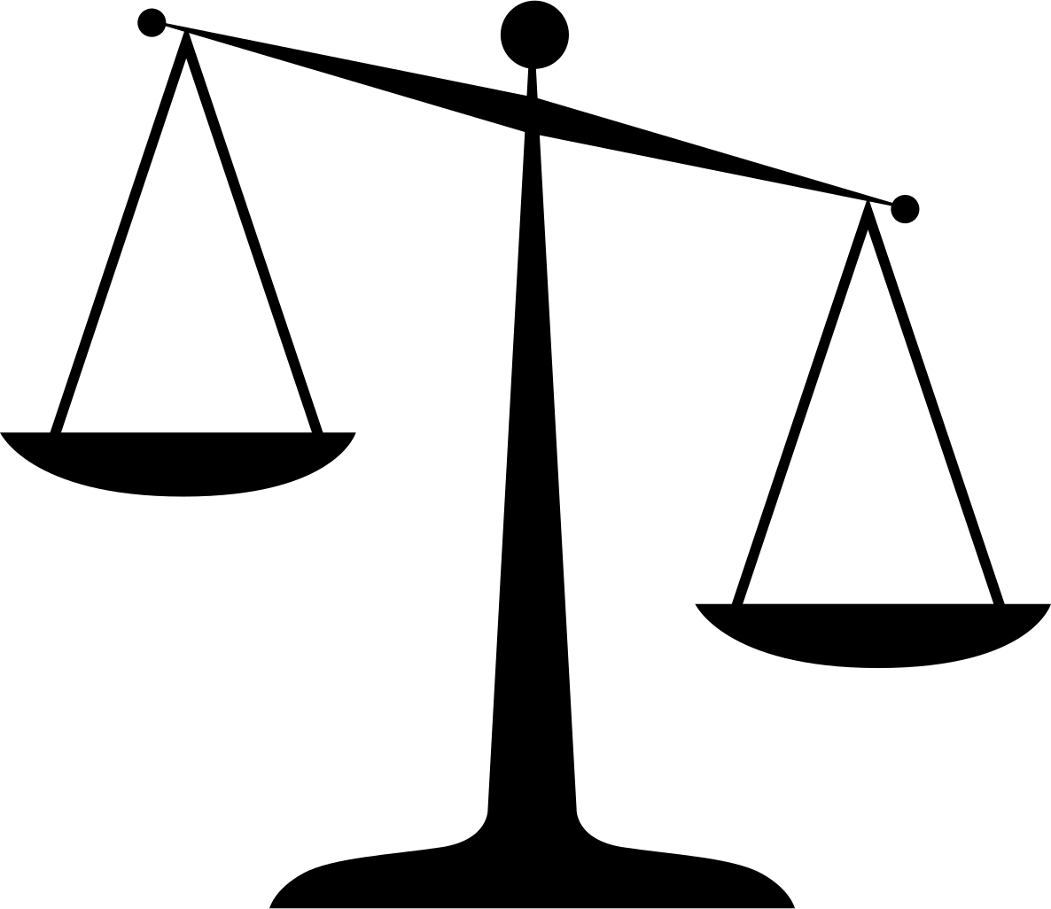
So let’s compare

Slide 6
Strengths & Weaknesses
 | Symbolic | Connectionist
Construction | Human effort | Data hunger
Scaleable | +/- | +/-
Explainable | + | -
Generalisable | Performance cliff | Performance cliff

Slide 7
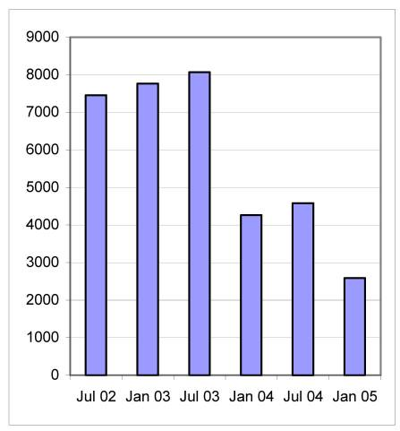

Strengths & Weaknesses
 | Symbolic | Connectionist
Construction | Human effort | Data hunger
Scaleable | +/- | +/-
Explainable | + | -
Generalisable | Performance cliff | Performance cliff
40 years of effort,
10.000 updates every years

Slide 8
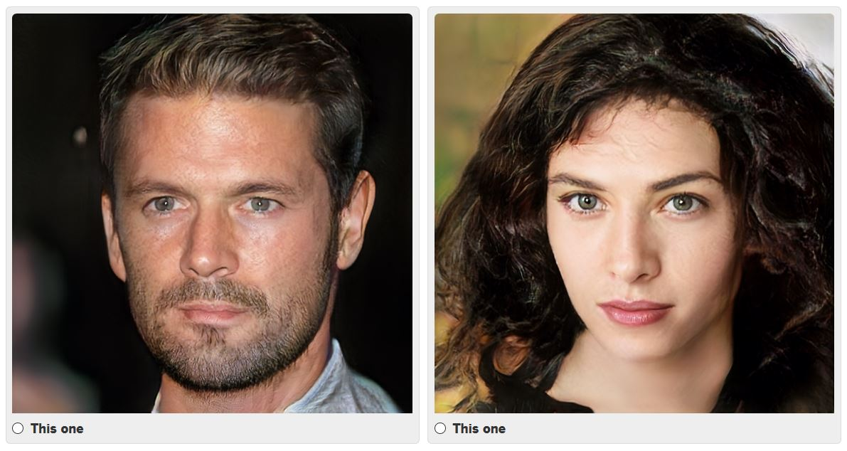
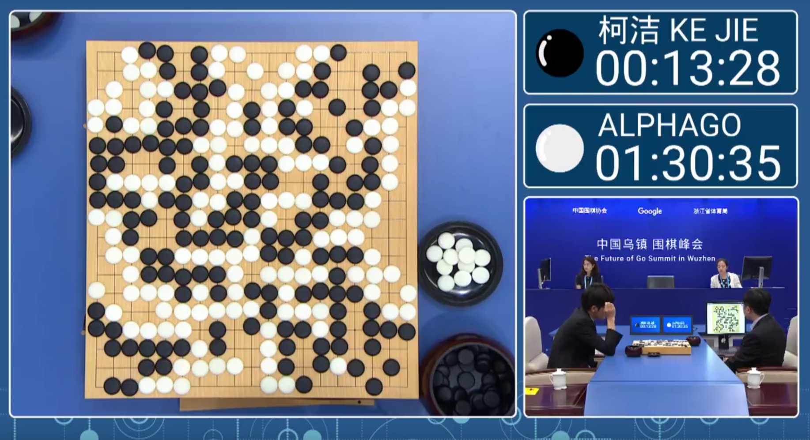
Strengths & Weaknesses
 | Symbolic | Connectionist
Construction | Human effort | Data hunger
Scalable | +/- | +/-
Explainable | + | -
Generalisable | Performance cliff | Performance cliff
10M training samples
4.8M training games

Slide 9
Strengths & Weaknesses
 | Symbolic | Connectionist
Construction | Human effort | Data hunger
Scaleable | +/- | +/-
Explainable | + | -
Generalisable | Performance cliff | Performance cliff
worse with
more data
worse with
less data

Slide 10
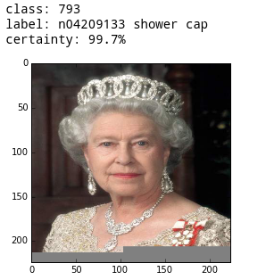
Strengths & Weaknesses
 | Symbolic | Connectionist
Construction | Human effort | Data hunger
Scaleable | +/- | +/-
Explainable | + | -
Generalisable | Performance cliff | Performance cliff
Class: 793
Label: n04209133 (shower cap)
Certainty: 99.7%

Slide 11
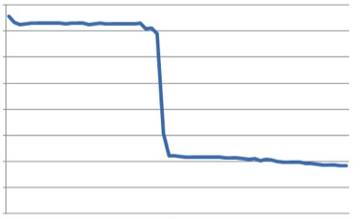
Strengths & Weaknesses
 | Symbolic | Connectionist
Construction | Human effort | Data hunger
Scaleable | +/- | +/-
Explainable | + | -
Generalisable | Performance cliff | Performance cliff
quality →
generality →

Slide 12

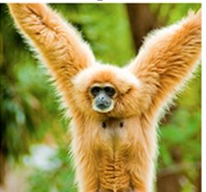
Strengths & Weaknesses
 | Symbolic | Connectionist
Construction | Human effort | Data hunger
Scaleable | +/- | +/-
Explainable | + | -
Generalisable | Performance cliff | Performance cliff

Slide 13
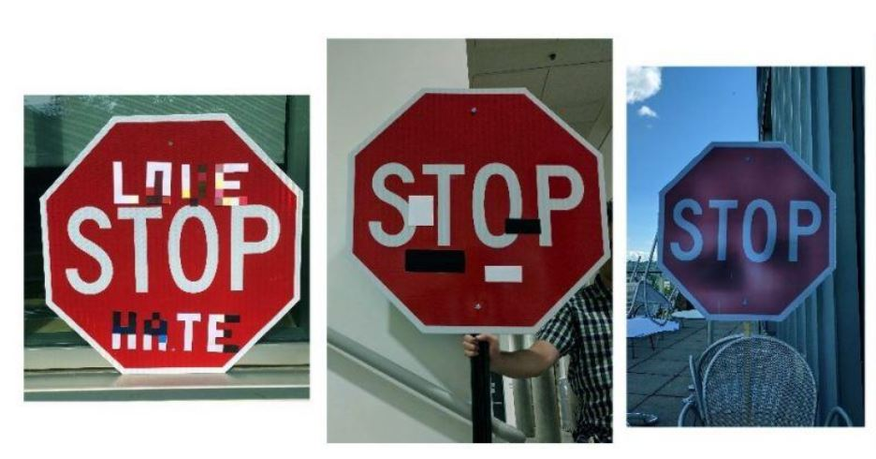


Strengths & Weaknesses
 | Symbolic | Connectionist
Construction | Human effort | Data hunger
Scaleable | +/- | +/-
Explainable | + | -
Generalisable | Performance cliff | Performance cliff

Slide 14

Can we get them
to collaborate?

Slide 15
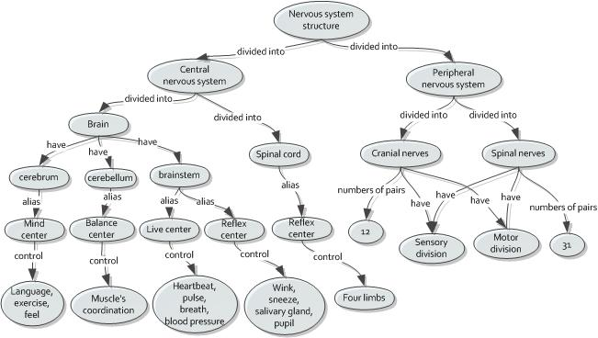
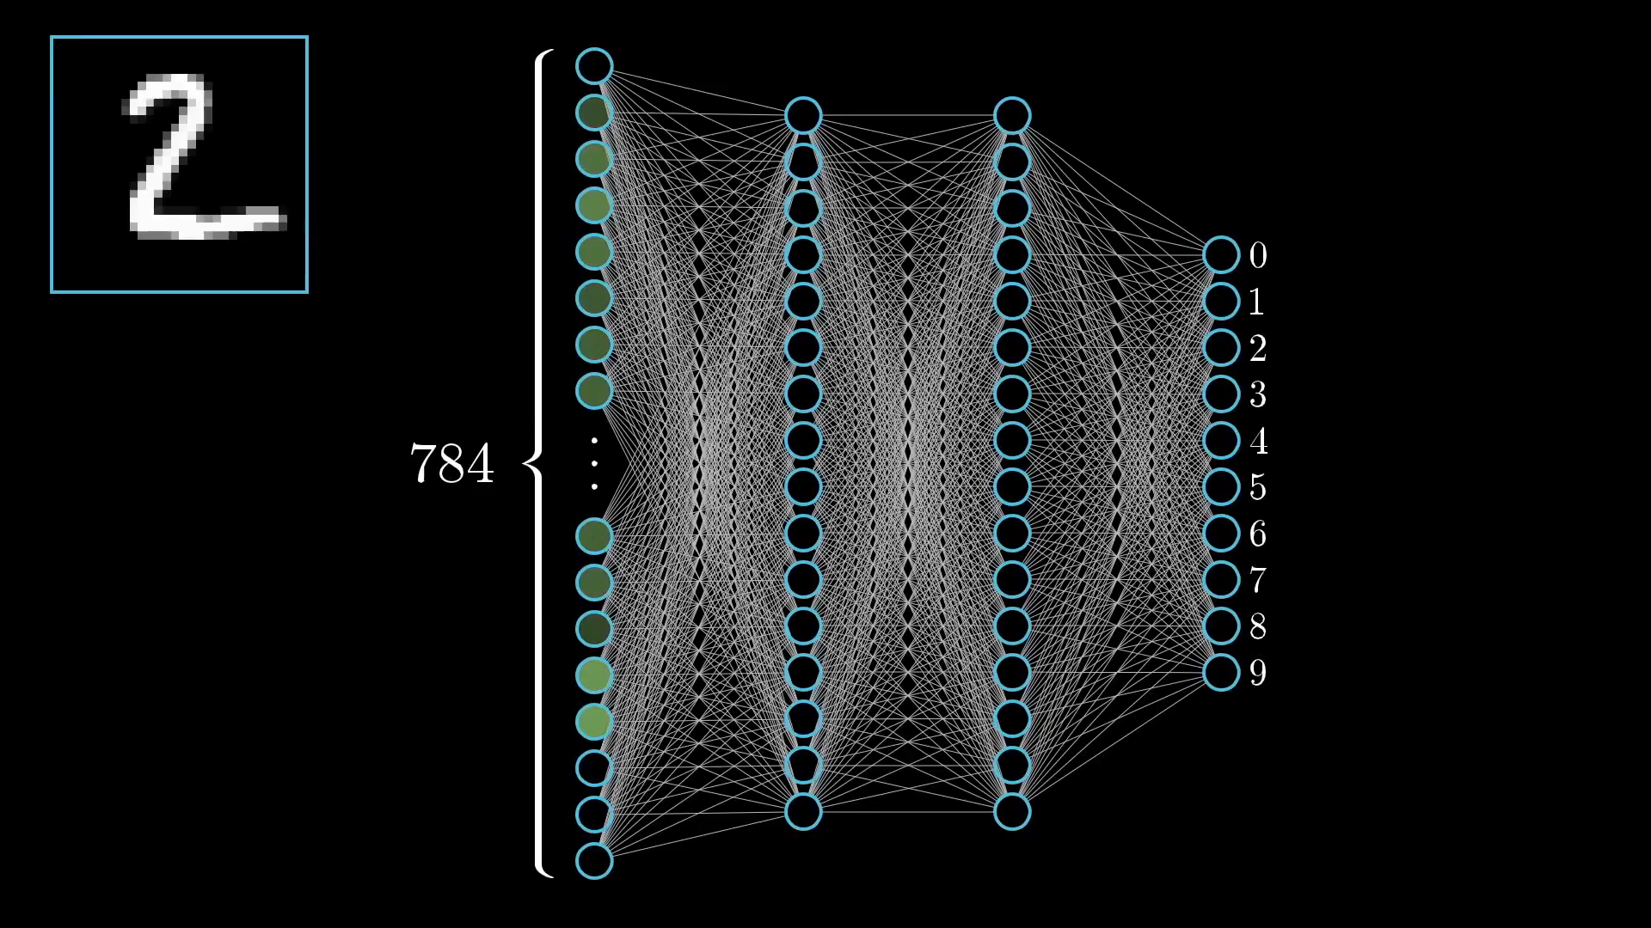
The representations are very different

Slide 16
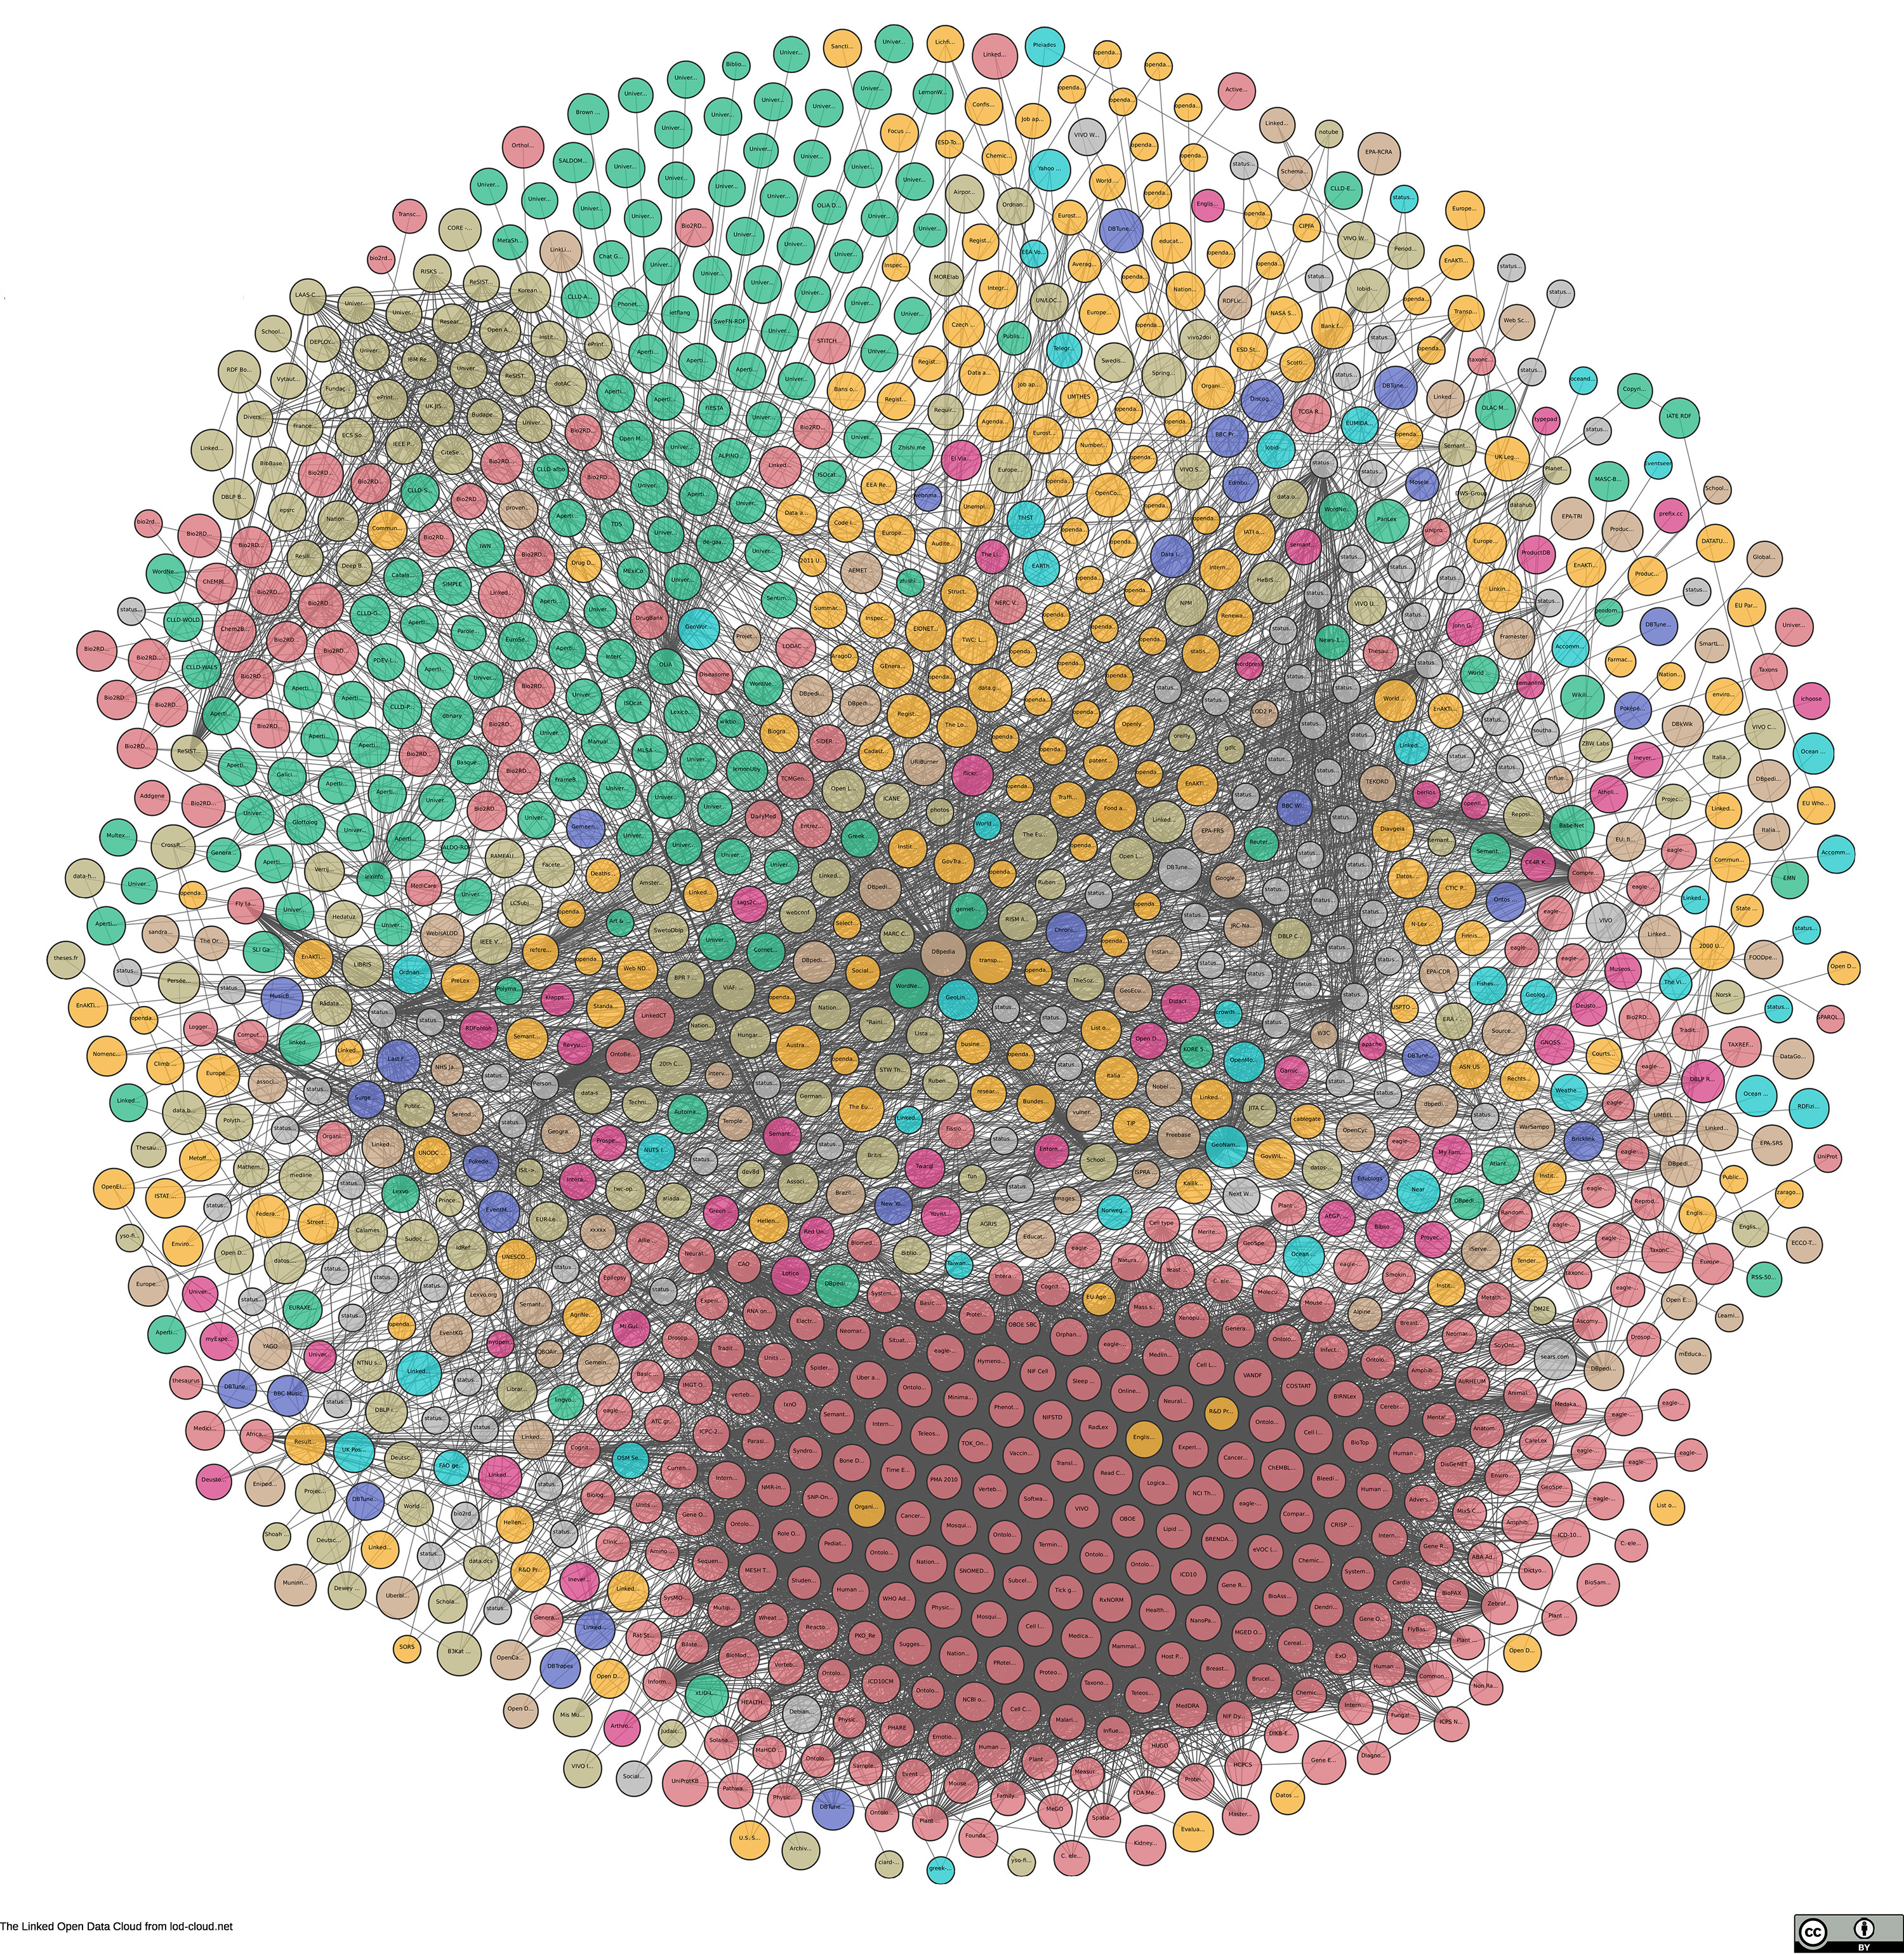
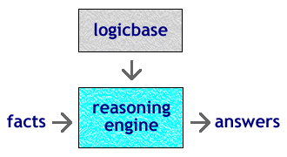
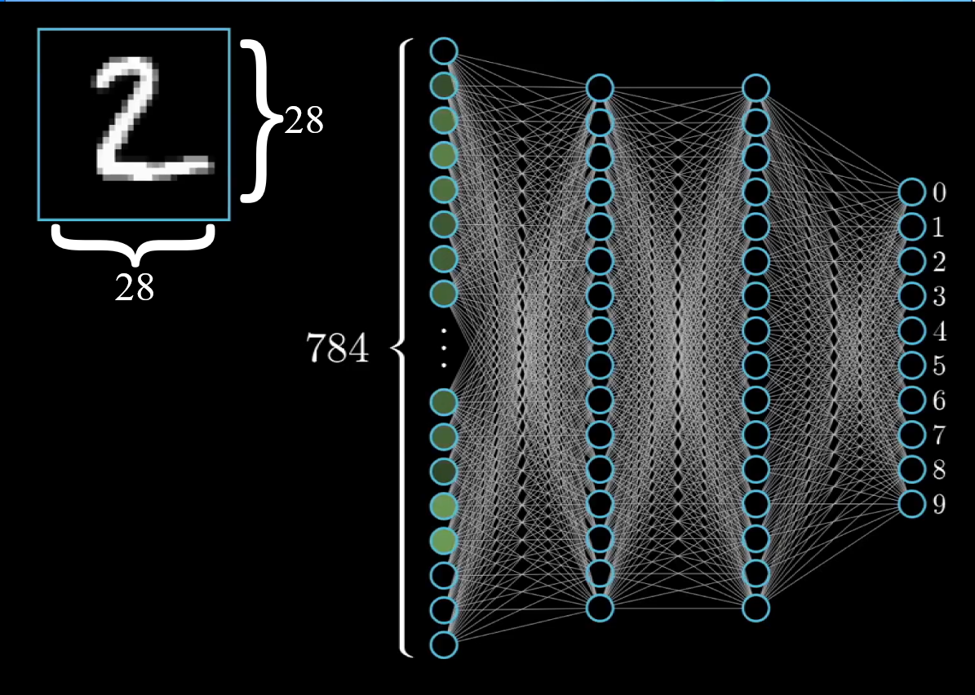
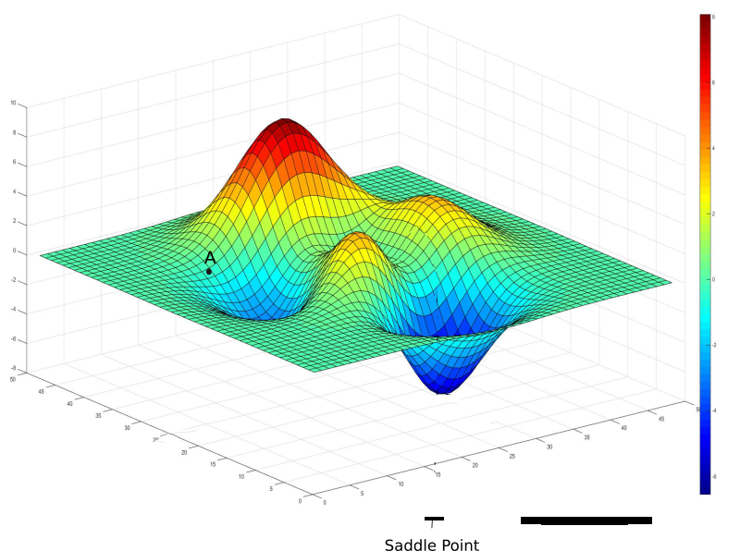
The reasoning is very different
Model- based
13.000 variables
Function- based
Adnan Darwiche

Slide 17
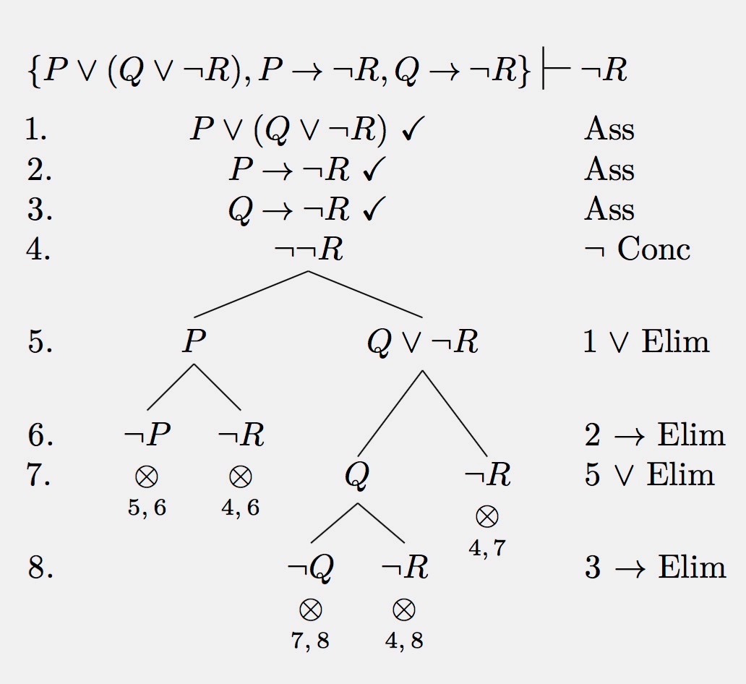
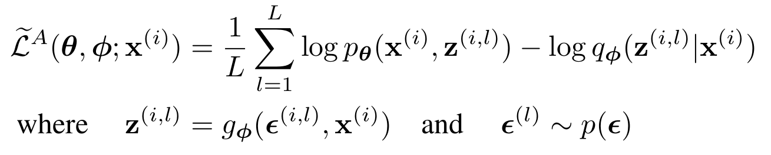
The math is very different

Slide 18
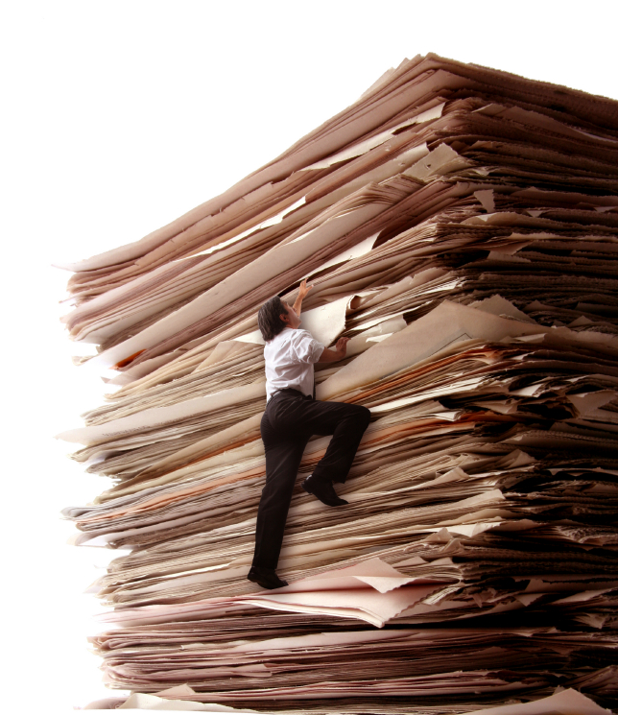

So we started reading…
2 years of weekly reading group ≈50 papers
3x 8-week seminar with 15 students ≈100 papers
It was a mess…
Lot’s of techniques, tricks, ideas, methods, math
No structure, no guidance, no map, no theory

Slide 19
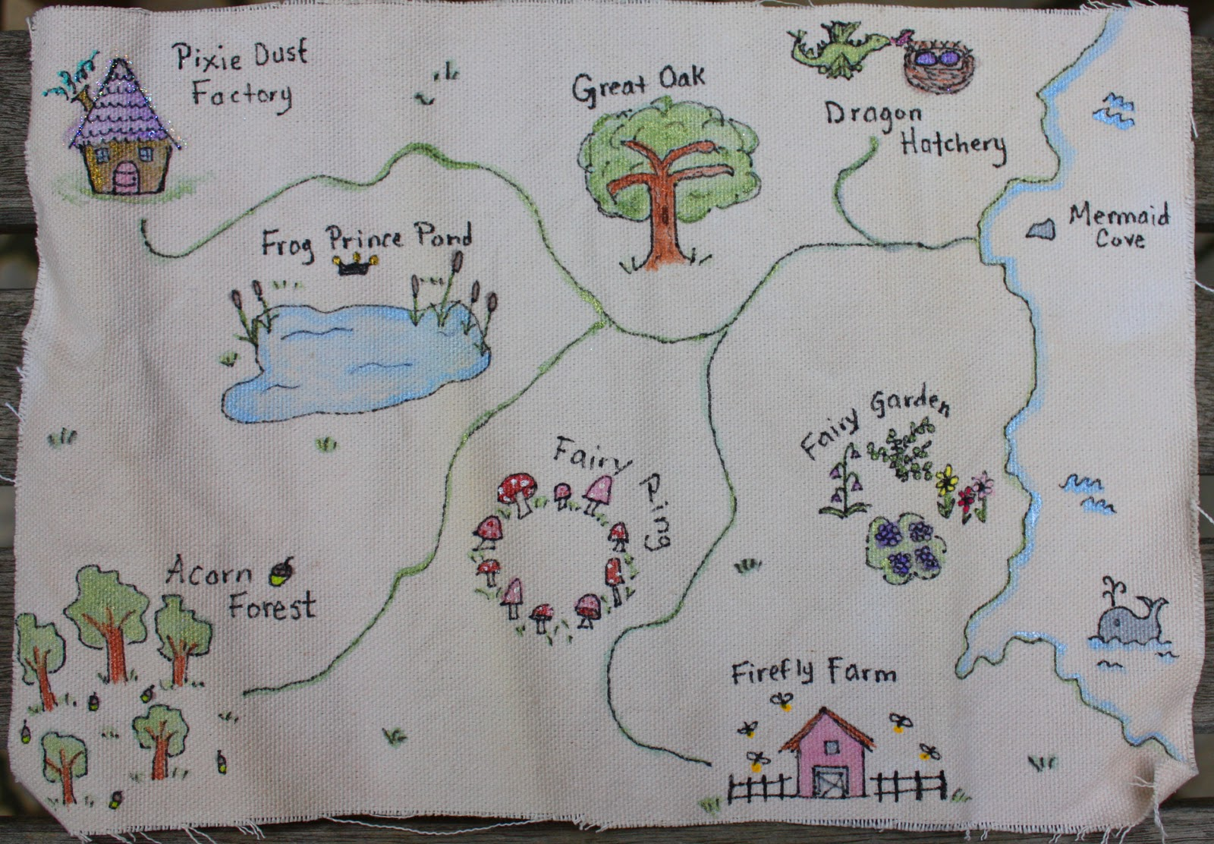
Modest goal: Can we make a reading map?
Not so modest goal:
Could this help us towards
a computational theory
of intelligent systems?

Slide 20
Inspired by Knowledge Engineering: a theory of re-usable patterns
Task templates
Task types

Slide 21
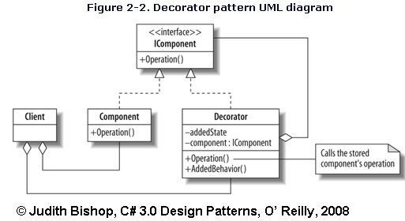
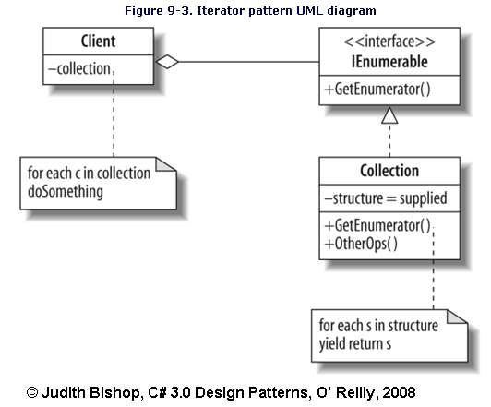
Inspired by Software Engineering: a theory of re-usable patterns

Slide 22
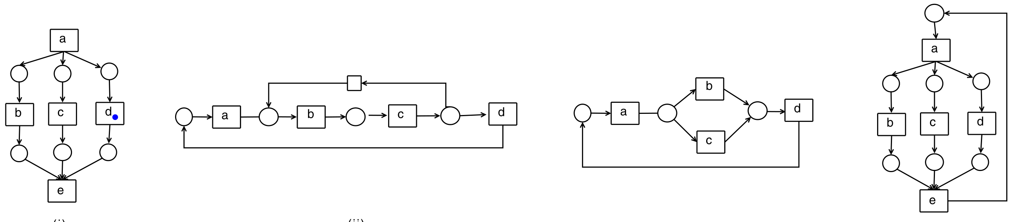
Inspired by Process Mining: a theory of re-usable patterns

Slide 23
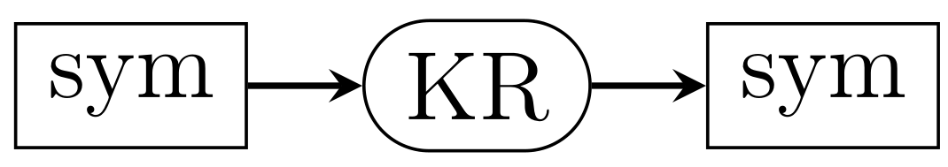
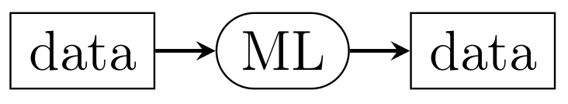
Plan:
compositional patterns loose coupling
Elementary components:

Slide 24
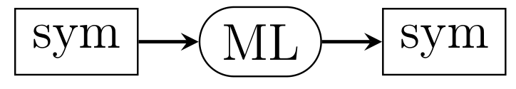
Simplest mixed pattern: Learning on symbols
Inductive Logic Programming
Probabilistic Soft Logic
Markov Logic Networks
All of these need Knowledge Engineering

Slide 25
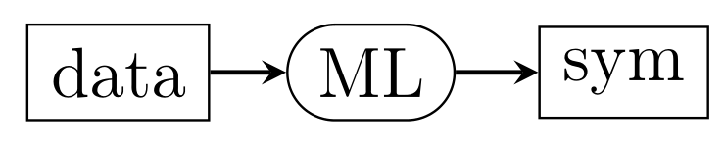
From data to symbols
Ontology learning from text
Knowledge graph learning from text
Also covers many “classical” learning algorithms:
Decision tree learning
Rule learning
All of these need Knowledge Engineering
All of these need Knowledge Engineering

Slide 26
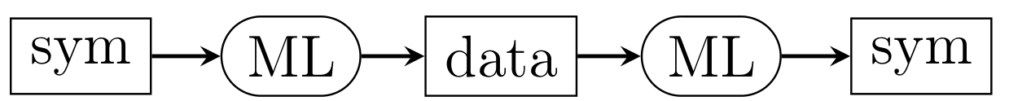
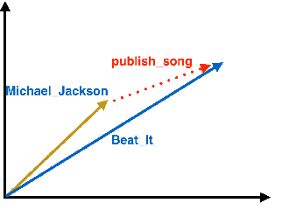
From symbols to data and back again
Knowledge Graph completion
Angi
Rolling Stones
Publish_song
Michael Jackson
Beat It

Slide 27
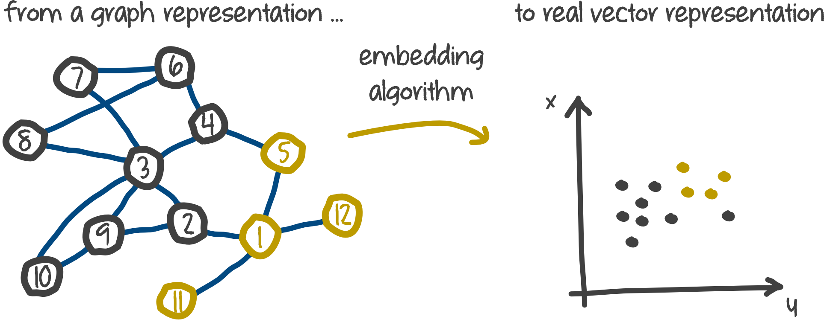
From symbols to data and back again
Knowledge Graph completion
prediction
algorithm

Slide 28
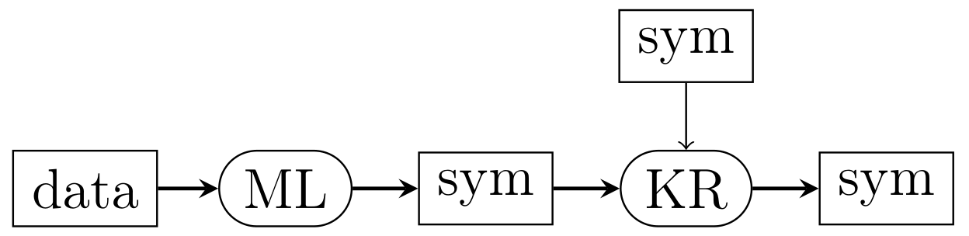
Generating an explanation
crown
wears
queen

Slide 29
Ranking hypotheses (≈ explaining why not)
crown
queen
showercap

Slide 30
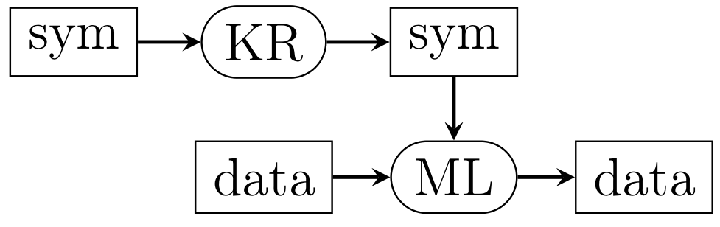
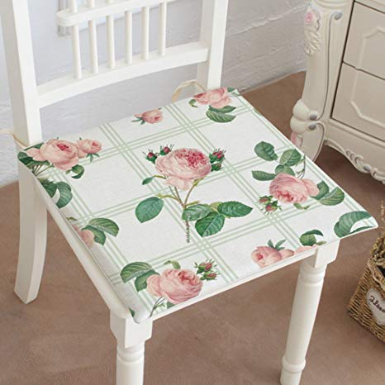
Symbolic prior
P(cushion|chair) >> P(flower|chair)

Slide 31
Symbolic prior
Also:
Semantic loss-function
Curriculum-guided learning

Slide 32
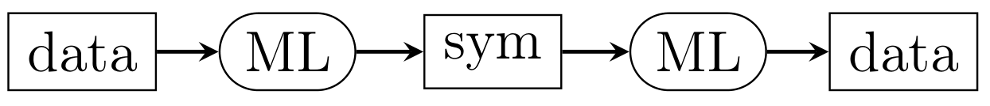
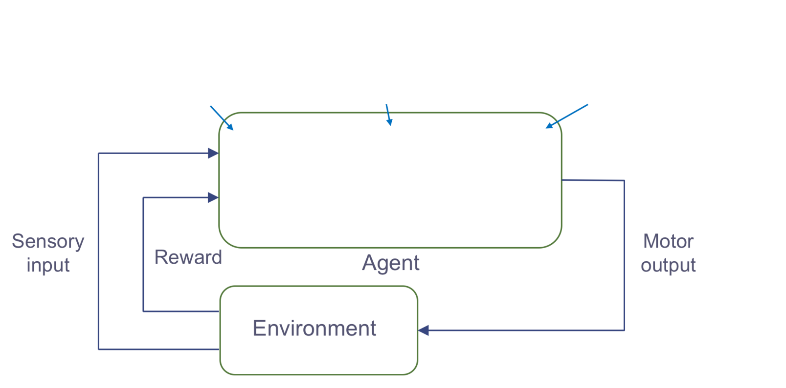
Learning intermediate abstractions
Example: Reinforcement learning for spatial navigation

Slide 33
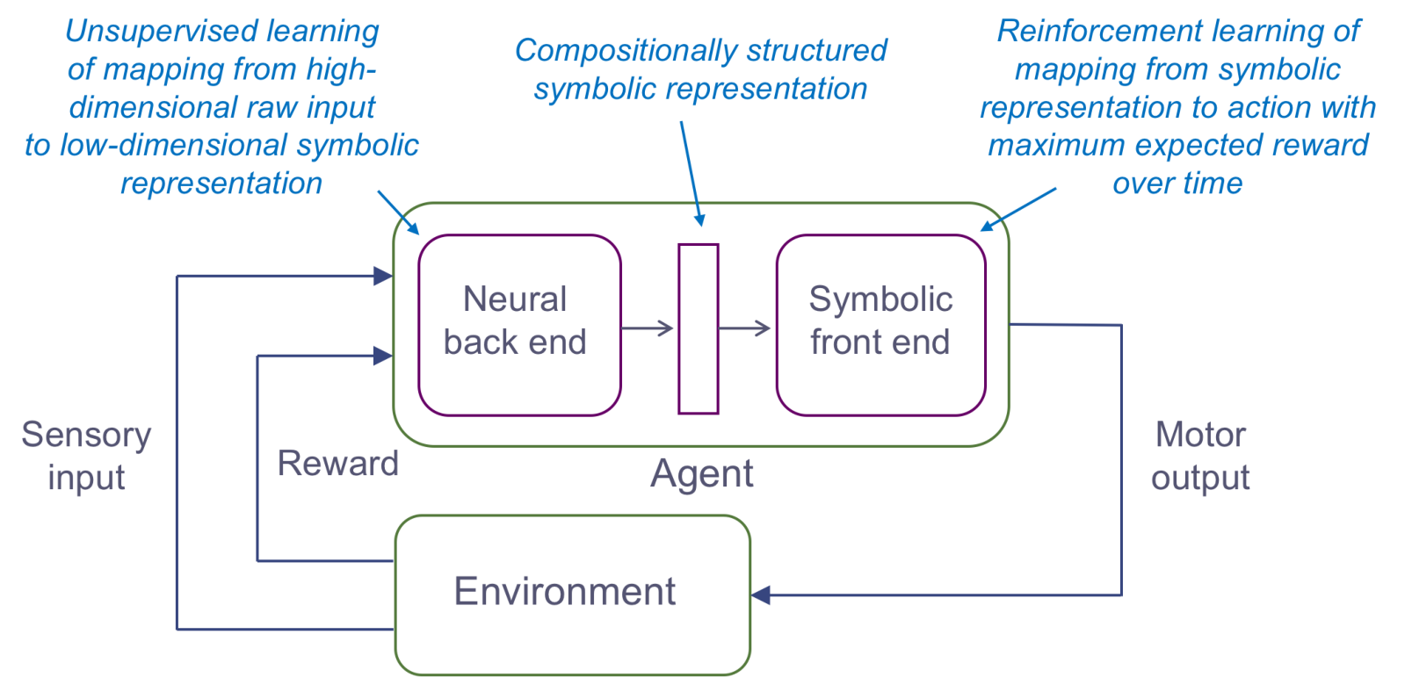
Learning intermediate abstractions
Example: Reinforcement learning for spatial navigation
Faster adaptation to changes;
Better transfer learning

Slide 34
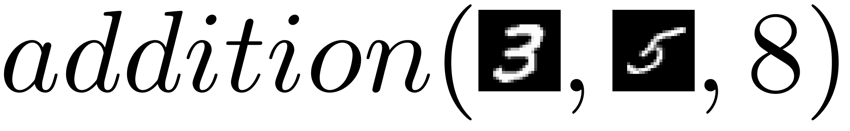
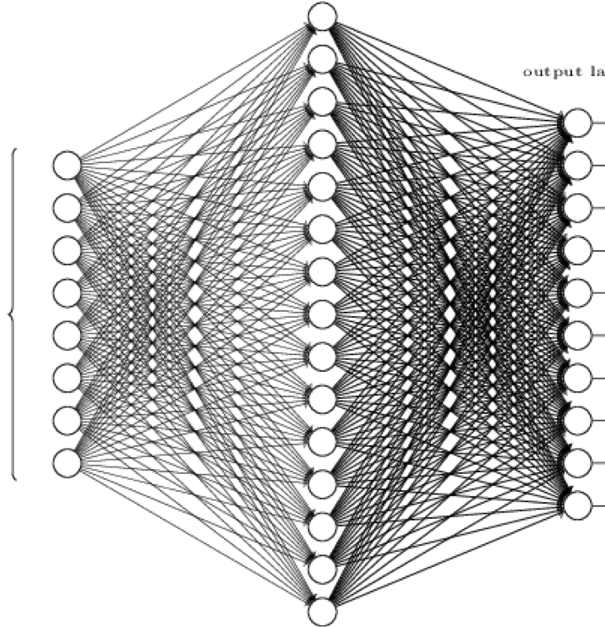
Learning intermediate abstractions
Example: separating perception from cognition
:- see( , 3), see( , 5), add(3,5).
Compare:
2x 784
inputs
19 outputs

Slide 35
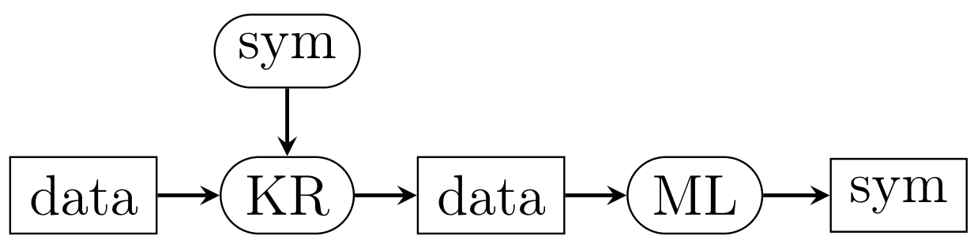
Learning from intermediate abstractions
Example:
Try to learn early symptoms of CRC from GP data: (symptoms, life style, diagnoses, drugs)
Raw data → no meaningful signal
Raw data + KG = abstracted data → significant results

Slide 36
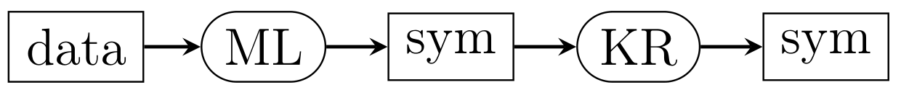
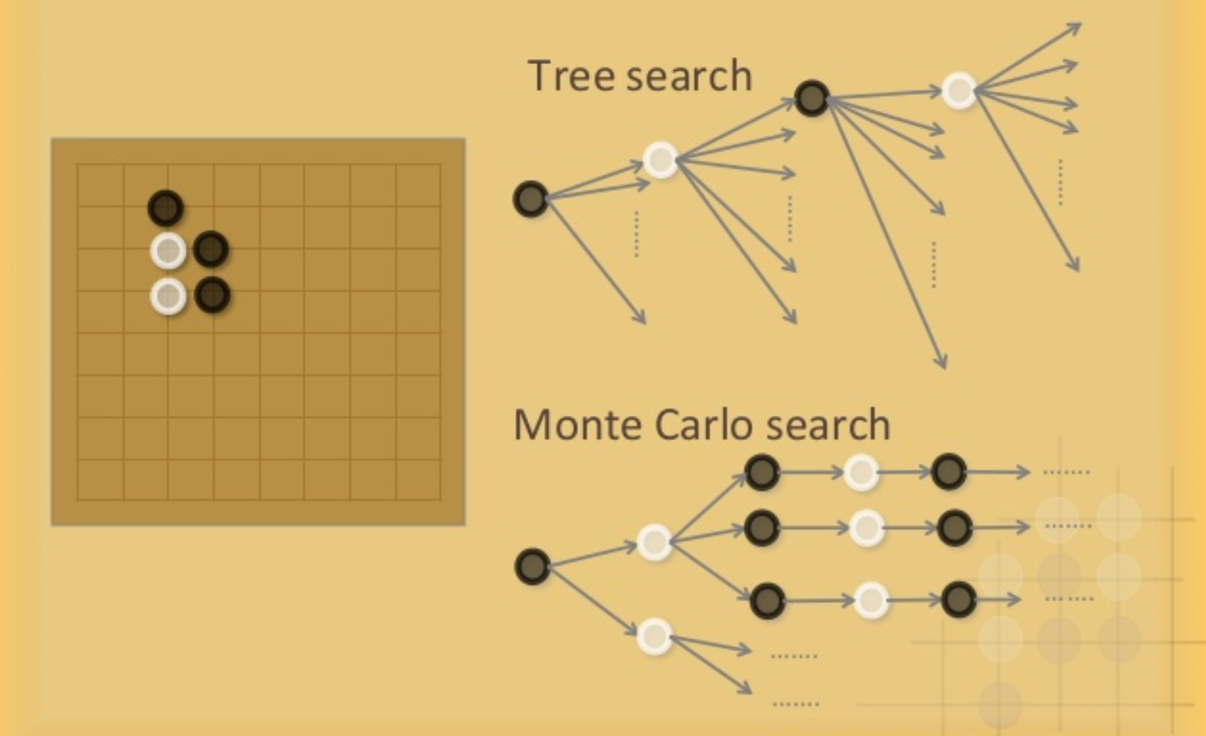
Learning intermediate abstractions

Slide 37
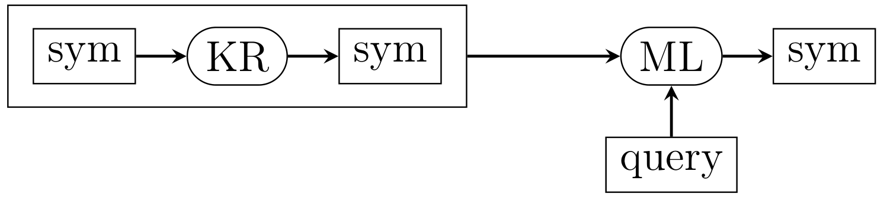
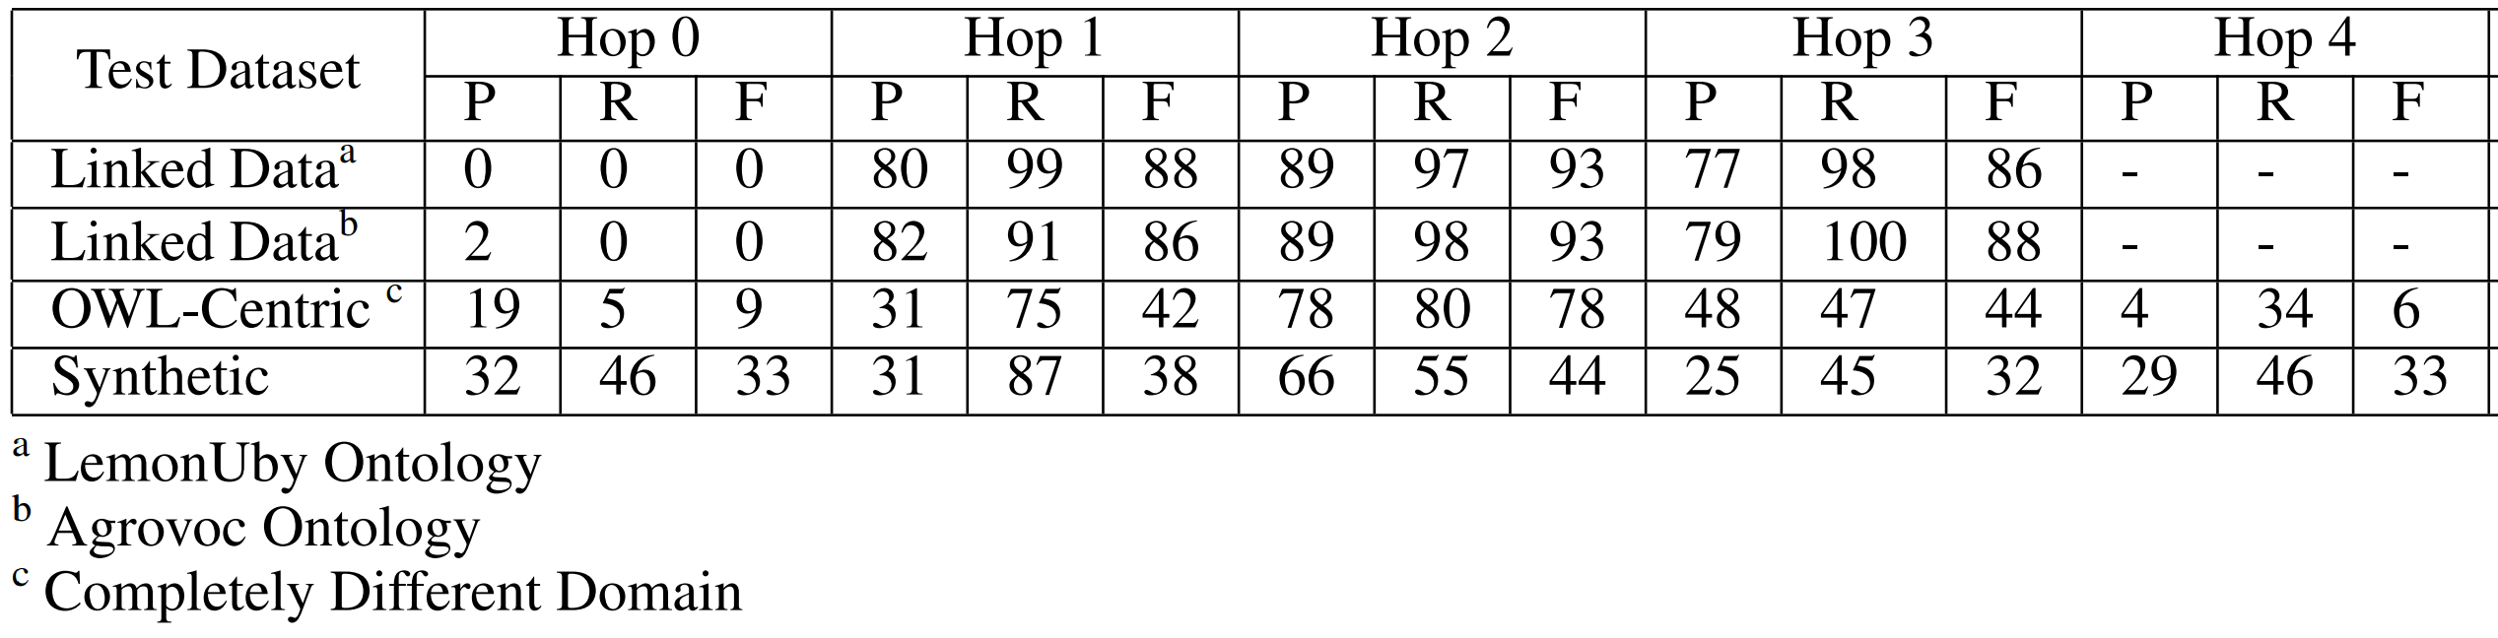
Learning (“imitating?”) to reason

Slide 38
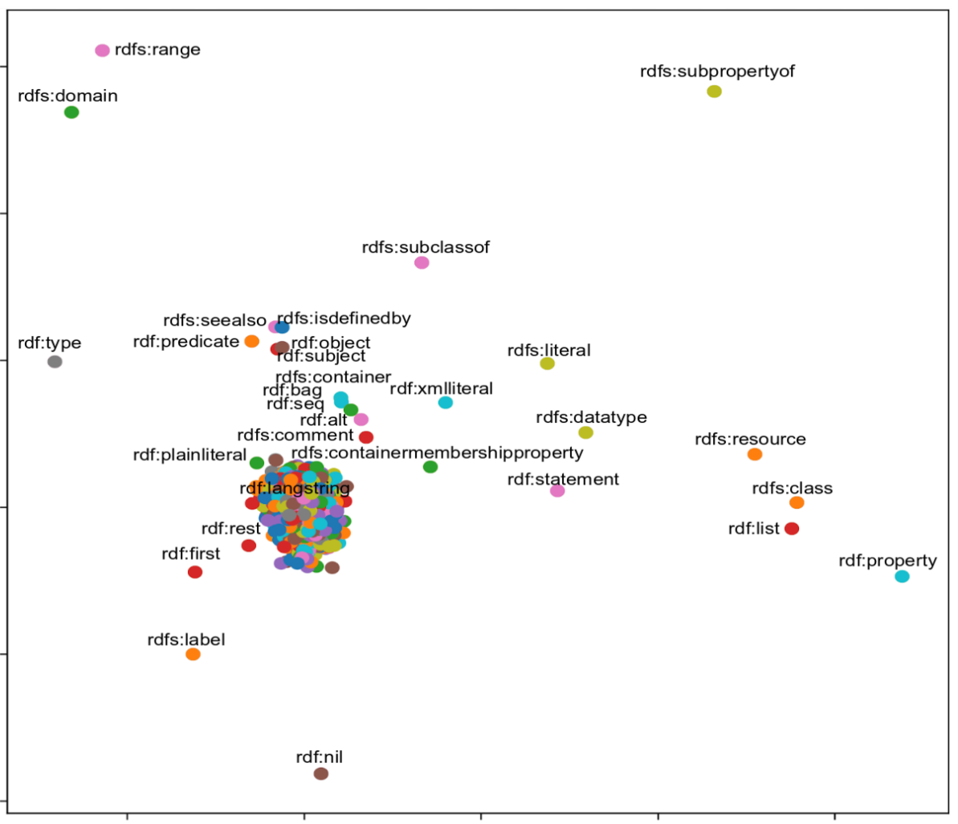
Learning (“imitating?”) to reason
Reasoning transfers
to other KG’s!

Slide 39
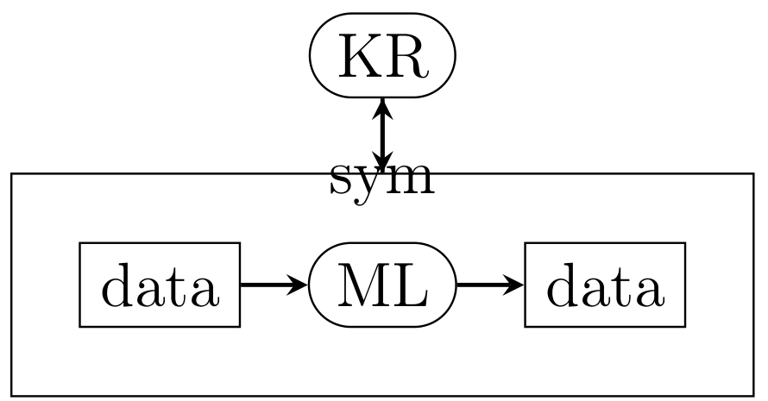
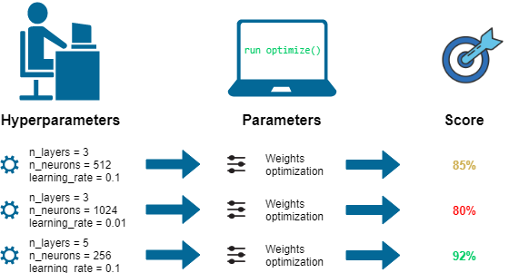


Knowledge-based auto-ML
Algorithmic configuration
Hyperparameter tuning
Selection of training examples

Slide 40

Concluding
remarks

Slide 41
Plan:
loose coupling + compositional patterns

Slide 42
Goal:
Create some structure in the huge number of proposals for combining learning and reasoning
Contribution:
A set of re-usable architectural patterns for such systems
In the style of knowledge engineering software engineering “any” engineering

